Slide 1
COT5615: Math for Intelligent Systems I
Anand Rangarajan
Lecture 10

Slide 2
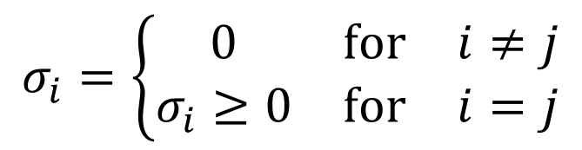
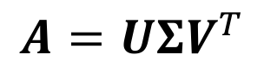
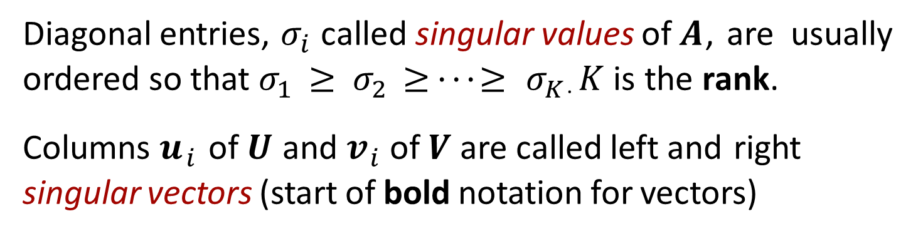
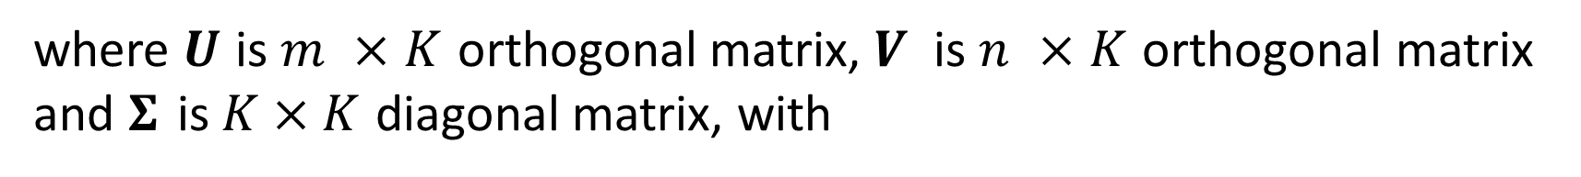
Singular Value Decomposition
Singular value decomposition (SVD) of $m × n$matrix $A$ has form
$$A=UΣV^{T}$$
where $U$ is $m ×K$ orthogonal matrix, $V$ is $n ×K$ orthogonal matrix and $Σ$ is $K×K$ diagonal matrix, with
$$σ_{i}=\left\{\begin{matrix}0 & for & i≠j \\ σ_{i}≥0 & for & i=j\end{matrix}\right.$$
Diagonal entries, $σ_{i}$ called singular values of $A$, are usually ordered so that $σ_{1} ≥ σ_{2} ≥ · · · ≥ σ_{K}$. $K$ is the rank.
Columns $u_{i}$ of $U$ and $v_{i}$ of $V$ are called left and right
singular vectors (start of bold notation for vectors)

Slide 3
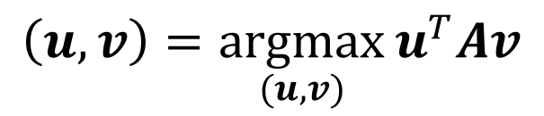
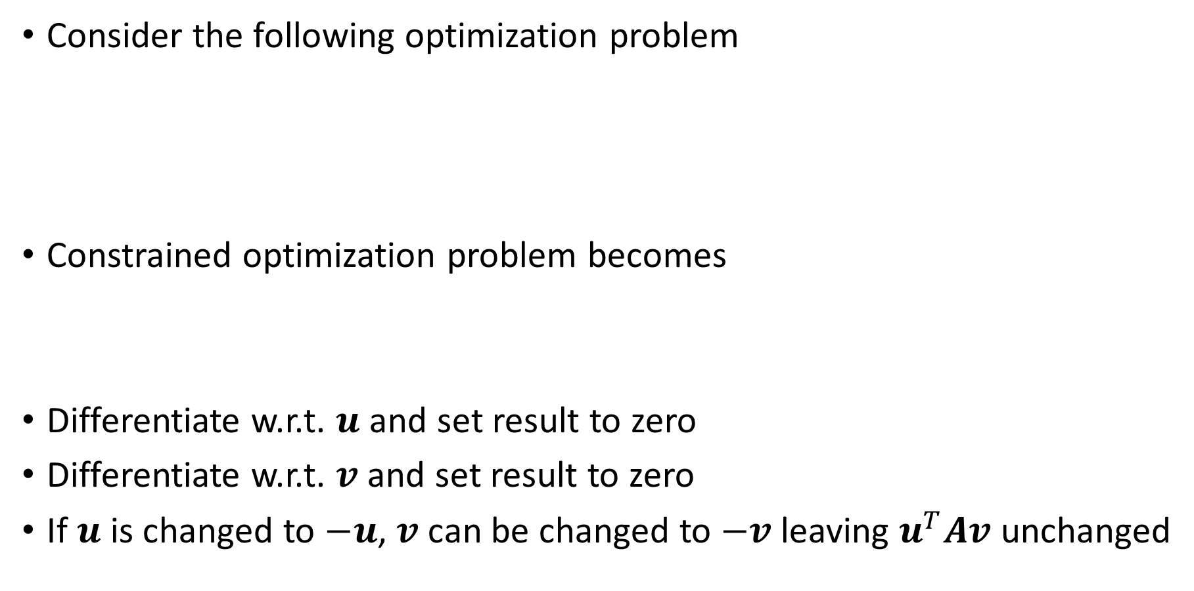
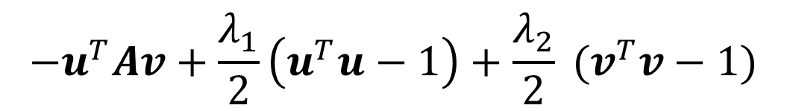
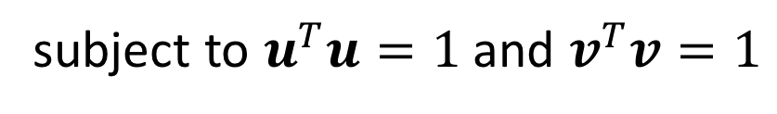
The SVD from a maximization principle
Consider the following optimization problem
Constrained optimization problem becomes
Differentiate w.r.t. $u$ and set result to zero
Differentiate w.r.t. $v$ and set result to zero
If $u$ is changed to $−u$, $v$ can be changed to $−v$ leaving $u^{T}Av$ unchanged
$$\left(u,v\right)=\underset{(u,v)}{argmax}{u^{T}Av}$$
subject to $u^{T}u=1$ and $v^{T}v=1$
$$−u^{T}Av+\frac{λ_{1}}{2}\left(u^{T}u−1\right)+\frac{λ_{2}}{2} (v^{T}v−1)$$

Slide 4
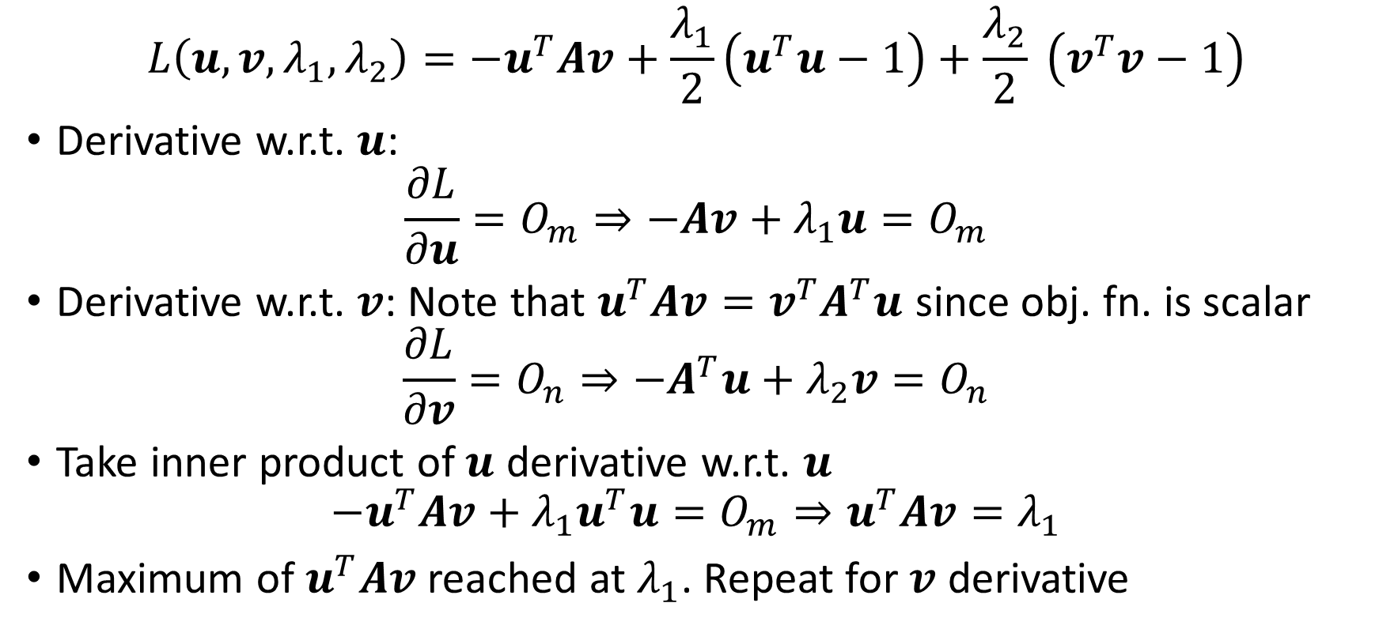
SVD optimization problem
$$L\left(u,v,λ_{1},λ_{2}\right)=−u^{T}Av+\frac{λ_{1}}{2}\left(u^{T}u−1\right)+\frac{λ_{2}}{2} \left(v^{T}v−1\right)$$
Derivative w.r.t. $u$:
$$\frac{∂L}{∂u}=O_{m}⇒−Av+λ_{1}u=O_{m}$$
Derivative w.r.t. $v$: Note that $u^{T}Av=v^{T}A^{T}u$ since obj. fn. is scalar
$$\frac{∂L}{∂v}=O_{n}⇒−A^{T}u+λ_{2}v=O_{n}$$
Take inner product of $u$ derivative w.r.t. $u$
$$−u^{T}Av+λ_{1}u^{T}u=O_{m}⇒u^{T}Av=λ_{1}$$
Maximum of $u^{T}Av$ reached at $λ_{1}$. Repeat for $v$ derivative

Slide 5
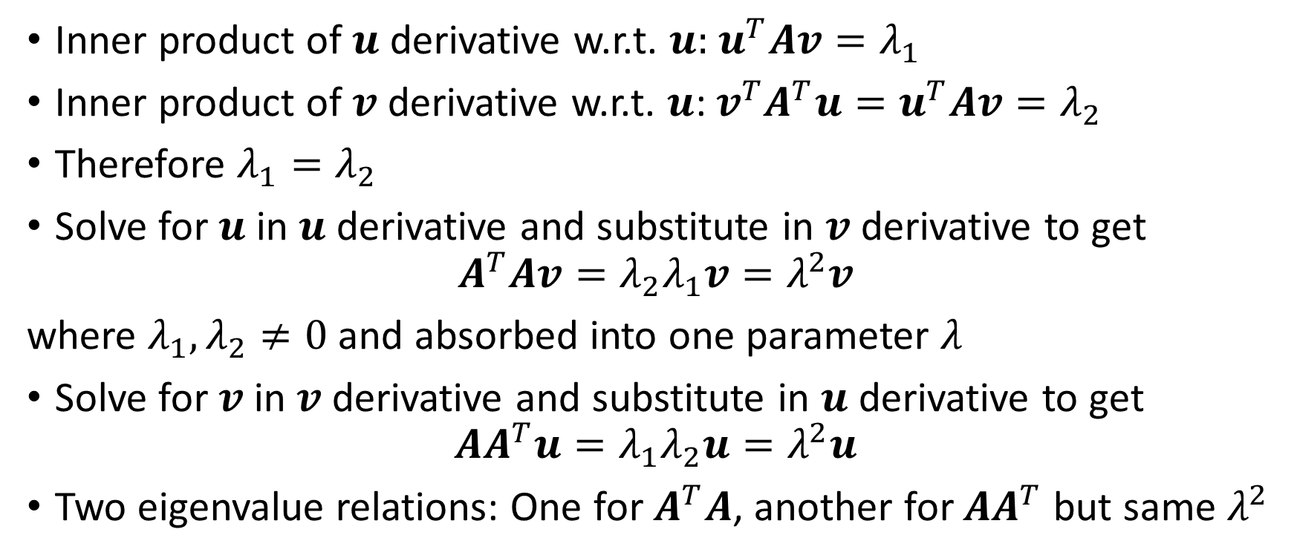
SVD optimization relations
Inner product of $u$ derivative w.r.t. $u:$ $u^{T}Av=λ_{1}$
Inner product of $v$ derivative w.r.t. $u$: $v^{T}A^{T}u=u^{T}Av=λ_{2}$
Therefore $λ_{1}=λ_{2}$
Solve for $u$ in $u$ derivative and substitute in $v$ derivative to get
$$A^{T}Av=λ_{2}λ_{1}v=λ^{2}v$$
where $λ_{1},λ_{2}≠0$ and absorbed into one parameter $λ$
Solve for $v$ in $v$ derivative and substitute in $u$ derivative to get
$$AA^{T}u=λ_{1}λ_{2}u=λ^{2}u$$
Two eigenvalue relations: One for $A^{T}A$, another for $AA^{T}$ but same $λ^{2}$

Slide 6
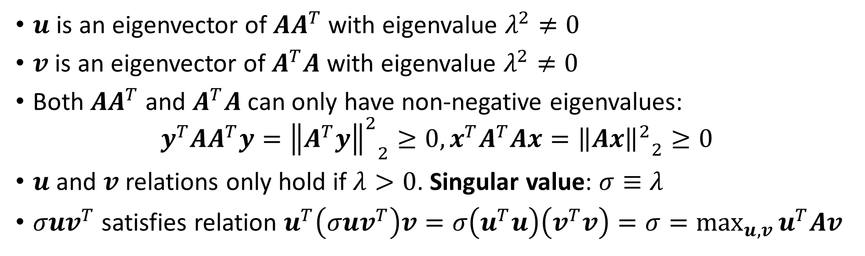
SVD optimization relations (contd.)
$u$ is an eigenvector of $AA^{T}$ with eigenvalue $λ^{2}≠0$
$v$ is an eigenvector of $A^{T}A$ with eigenvalue $λ^{2}≠0$
Both $AA^{T}$ and $A^{T}A$ can only have non-negative eigenvalues:
$$y^{T}AA^{T}y={{\left\|A^{T}y\right\|}^{2}}_{2}≥0, x^{T}A^{T}Ax={{\left\|Ax\right\|}^{2}}_{2}≥0$$
$u$ and $v$ relations only hold if $λ>0$. Singular value: $σ≡λ$
$σuv^{T}$ satisfies relation $u^{T}\left(σuv^{T}\right)v=σ\left(u^{T}u\right)\left(v^{T}v\right)=σ=\max_{u,v}{u^{T}Av}$

Slide 7
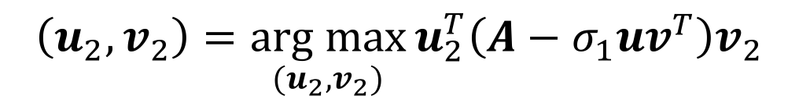
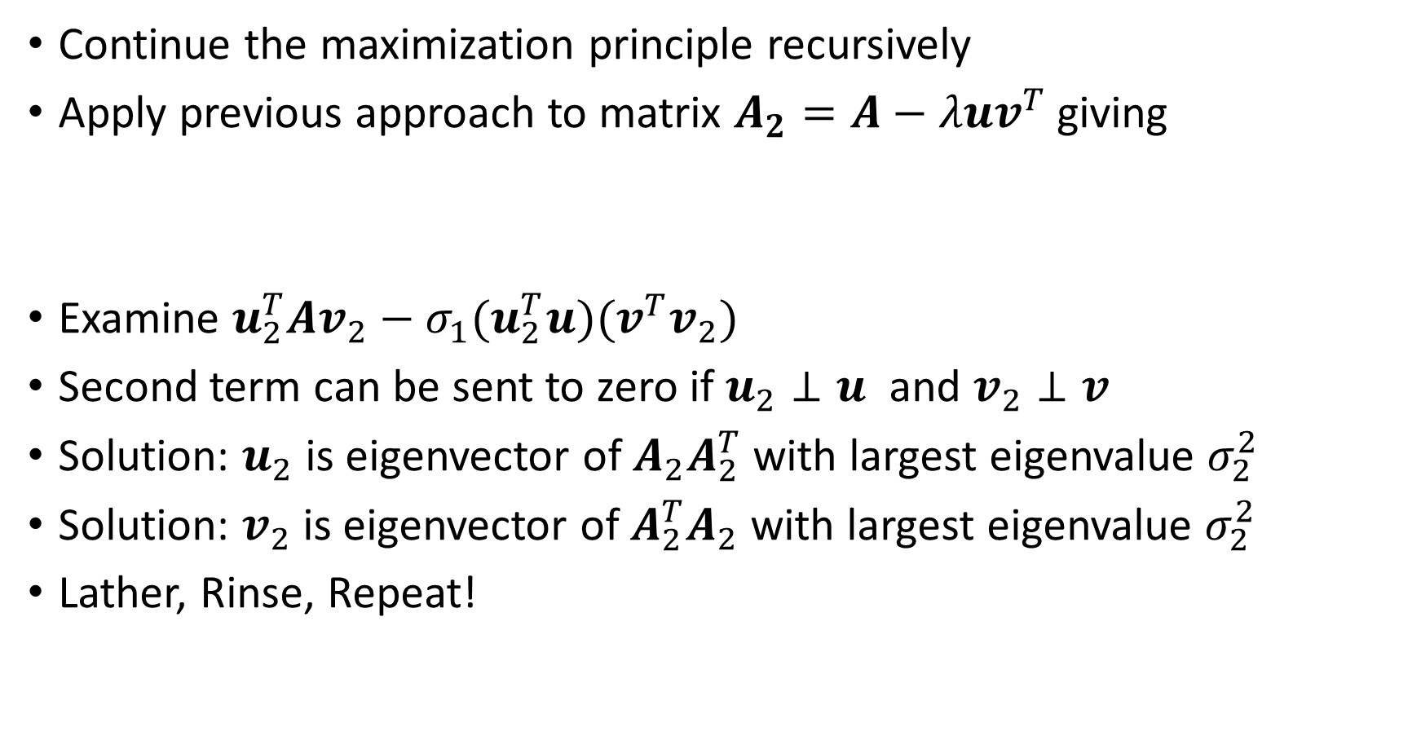
The SVD from a maximization principle (contd.)
Continue the maximization principle recursively
Apply previous approach to matrix $A_{2}=A−λuv^{T}$ giving
Examine $u_{2}^{T}Av_{2}−σ_{1}(u_{2}^{T}u)(v^{T}v_{2})$
Second term can be sent to zero if $u_{2}⊥u$ and $v_{2}⊥v$
Solution: $u_{2}$ is eigenvector of $A_{2}A_{2}^{T}$ with largest eigenvalue $σ_{2}^{2}$
Solution: $v_{2}$ is eigenvector of $A_{2}^{T}A_{2}$ with largest eigenvalue $σ_{2}^{2}$
Lather, Rinse, Repeat!
$$\left(u_{2},v_{2}\right)=\underset{(u_{2},v_{2})}{arg max}{u_{2}^{T}\left(A−σ_{1}uv^{T}\right)v_{2}}$$

Slide 8
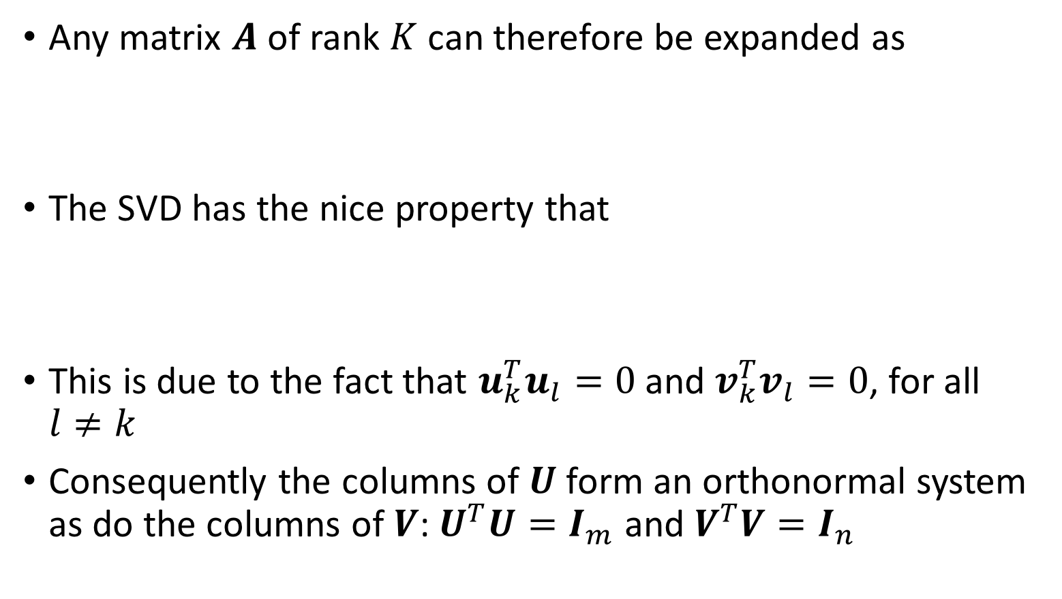
The SVD expansion
Any matrix $A$ of rank $K$ can therefore be expanded as
The SVD has the nice property that
This is due to the fact that $u_{k}^{T}u_{l}=0$ and $v_{k}^{T}v_{l}=0$, for all $l≠k$
Consequently the columns of $U$ form an orthonormal system as do the columns of $V$: $U^{T}U=I_{m}$ and $V^{T}V=I_{n}$
$$A=σ_{1}u_{1}v_{1}^{T}+σ_{2}u_{2}v_{2}^{T}+⋯+σ_{K}u_{K}v_{K}^{T}=UΣV^{T}$$
$$u_{k}^{T}Av_{k}=u_{k}^{T}\left(σ_{1}u_{1}v_{1}^{T}+σ_{2}u_{2}v_{2}^{T}+⋯+σ_{K}u_{K}v_{K}^{T} \right)v_{k}=σ_{k}$$

Slide 9
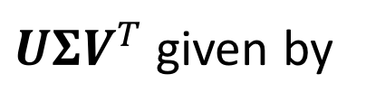
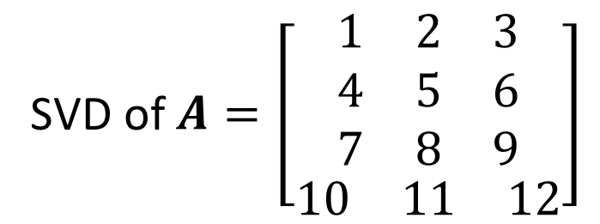
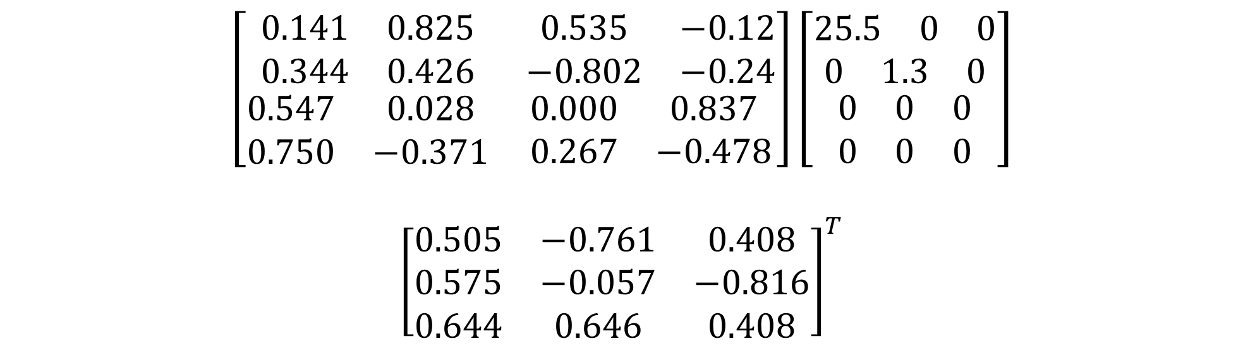
Example SVD
SVD of $A=\left[\begin{matrix}\begin{matrix}1 & 2 & 3 \\ 4 & 5 & 6 \\ 7 & 8 & 9\end{matrix} \\ \begin{matrix}10 & 11 & 12\end{matrix}\end{matrix}\right]$
$UΣV^{T}$ given by
$$\left[\begin{matrix}\begin{matrix}0.141 & 0.825 \\ 0.344 & 0.426\end{matrix} & \begin{matrix}0.535 & −0.12 \\ −0.802 & −0.24\end{matrix} \\ \begin{matrix}0.547 & 0.028 \\ 0.750 & −0.371\end{matrix} & \begin{matrix}0.000 & 0.837 \\ 0.267 & −0.478\end{matrix}\end{matrix}\right]\left[\begin{matrix}\begin{matrix}\begin{matrix}25.5 & 0 & 0\end{matrix} \\ \begin{matrix}0 & 1.3 & 0\end{matrix}\end{matrix} \\ \begin{matrix}\begin{matrix}0 & 0 & 0\end{matrix} \\ \begin{matrix}0 & 0 & 0\end{matrix}\end{matrix}\end{matrix}\right]$$
$${\left[\begin{matrix}0.505 & −0.761 & 0.408 \\ 0.575 & −0.057 & −0.816 \\ 0.644 & 0.646 & 0.408\end{matrix}\right]}^{T}$$

Slide 10
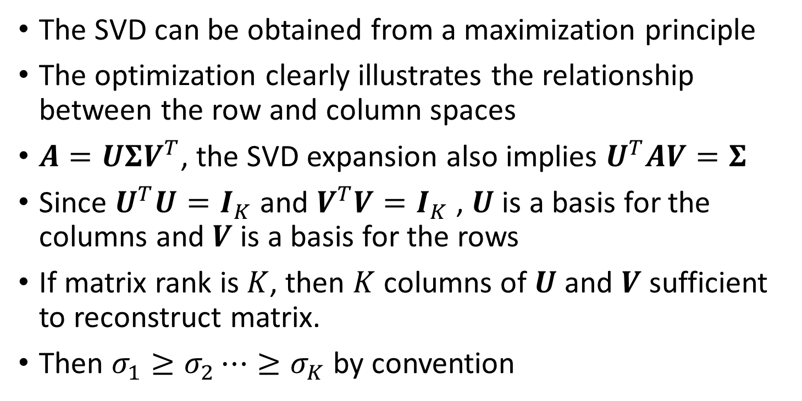
Conclusions
The SVD can be obtained from a maximization principle
The optimization clearly illustrates the relationship between the row and column spaces
$A=UΣV^{T}$, the SVD expansion also implies $U^{T}AV=Σ$
Since $U^{T}U=I_{K}$ and $V^{T}V=I_{K}$ , $U$ is a basis for the columns and $V$ is a basis for the rows
If matrix rank is $K$, then $K$ columns of $U$ and $V$ sufficient to reconstruct matrix.
Then $σ_{1}≥σ_{2}⋯≥σ_{K}$ by convention

Slide 11
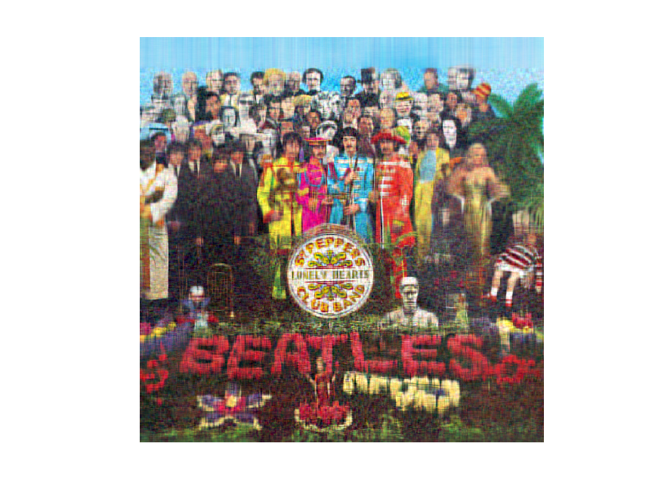


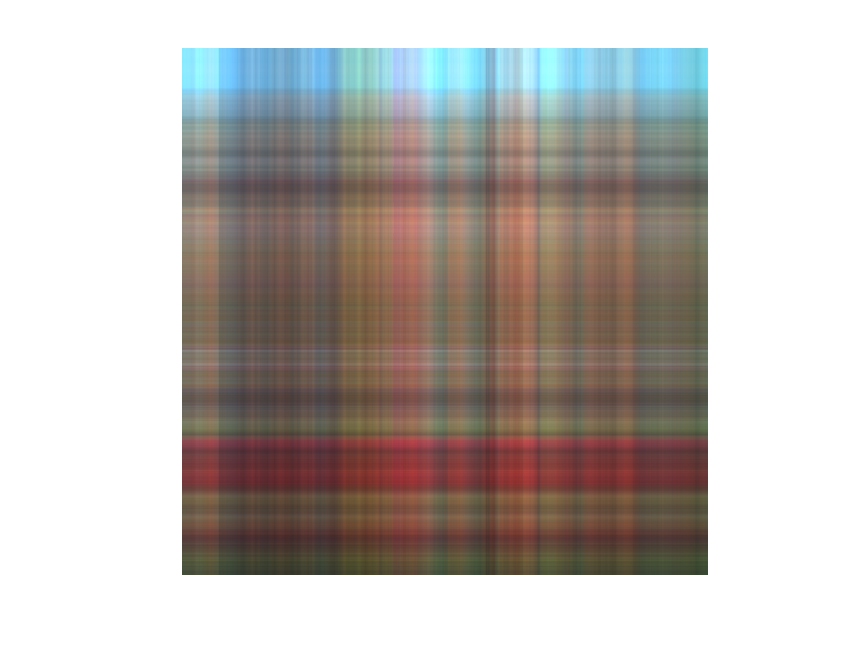
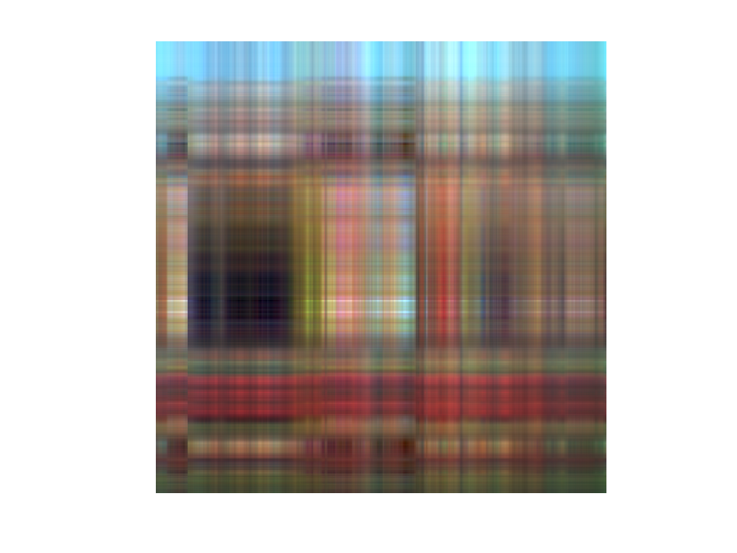
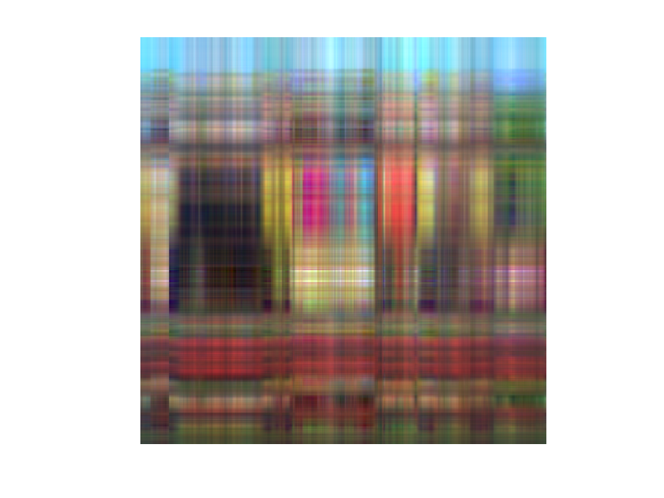
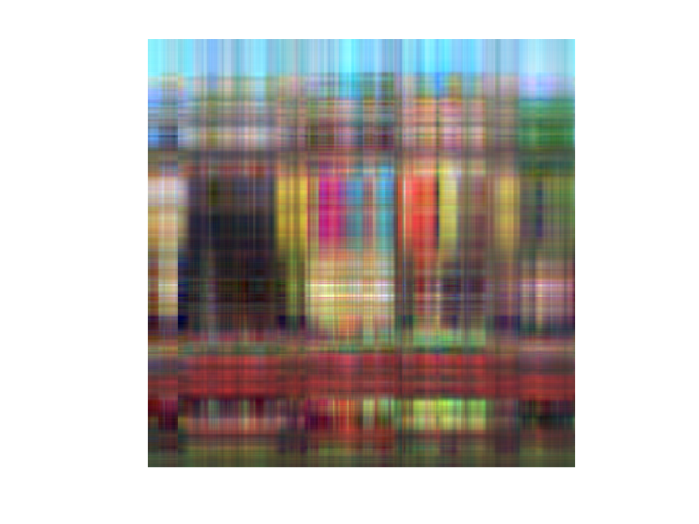
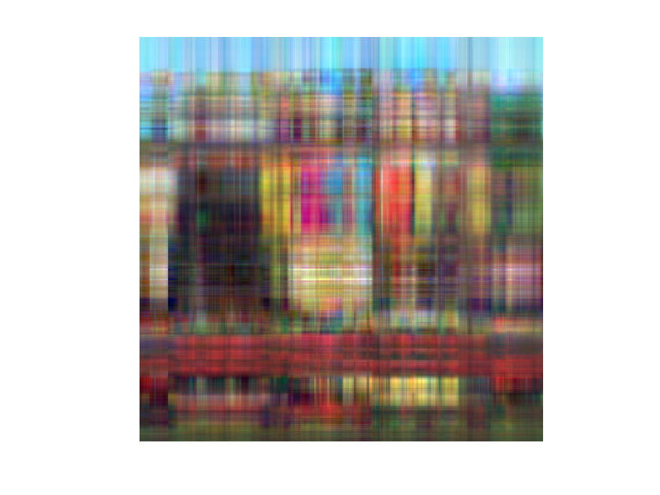










17
14
10
12
6
8
1
2
3
4
5
7
9
50
20
30
100
200

Slide 13
Conclusions
SVD can serve as image reconstruction/compression mechanism
Very few coefficients are required for recognition
Sets the stage for convolutional filtering (deep learning)
HOSVD can be used for color and higher-order images (4D)
SVD-based image compression not used: wavelets and other methods are more efficient

